Slide 1
ICE CREAM MANAGER

Slide 2
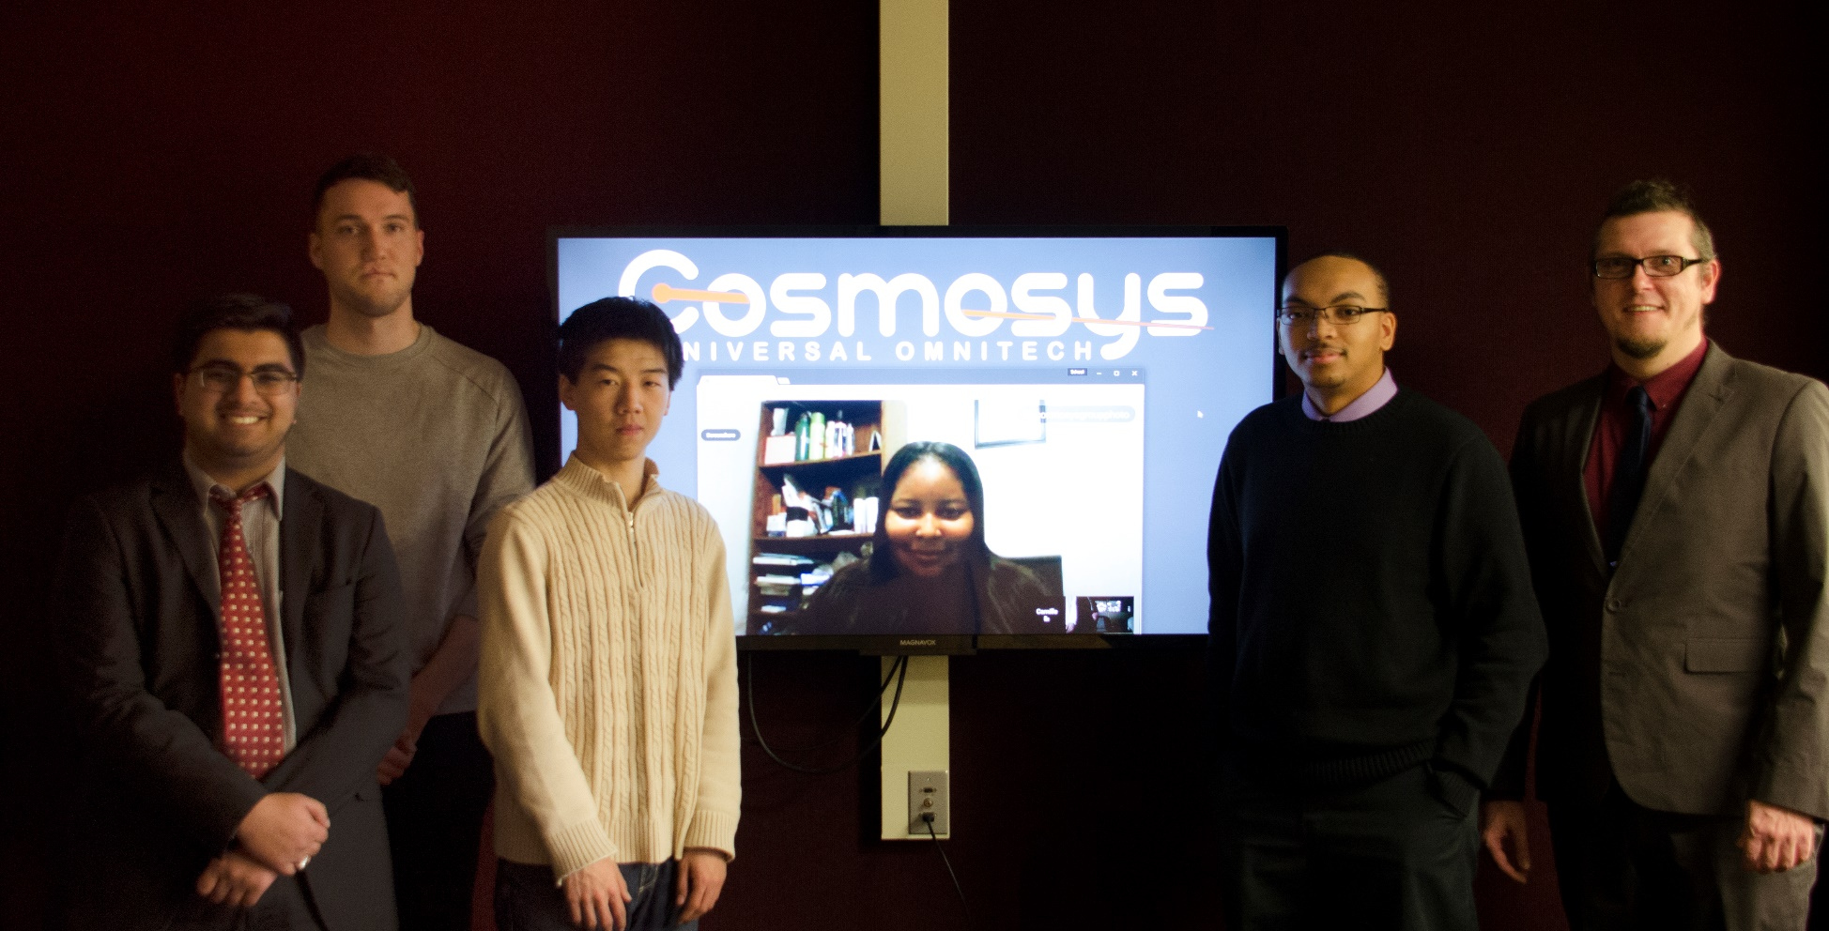
Development Team
(Left to Right) Aly Lakhani, Jacob Vacheresse, Fan Zhang, Camille Williams, Rodney Lewis, and Marc King

Slide 3
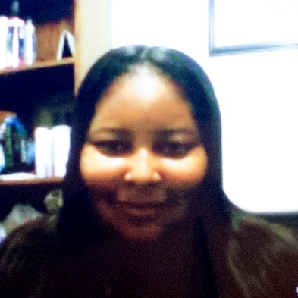

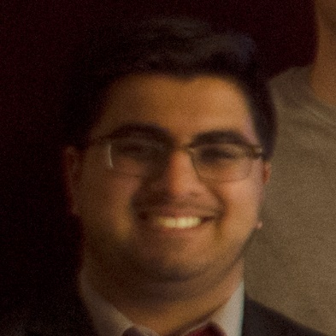
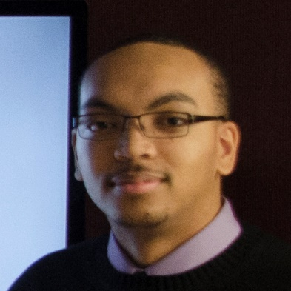

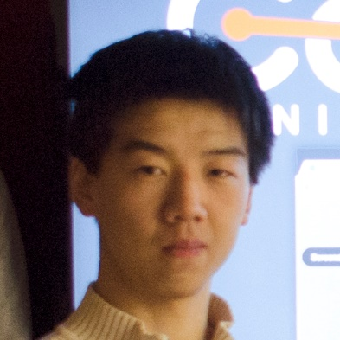
Team Structure
Camille Williams
Project Manager
Marc King
User Experience
Aly Lakhani
User Interface
Rodney Lewis
Architecture Design
Jacob Vacheresse
Algorithm Implementation
Fan Zhang
Data Modeling

Slide 4
Additional Functionality
Customer Voting (Fan)
Poll Customers for New Ice Cream
Poll Customers for Existing Ice Cream
Poll Customer Service Opinions
Change Inventory from Polling Report
Inventory Presets (Aly)
Truck Presets
Route Level Presets
Seasonal Company Presets
Monthly Company Presets
Fuel Tracking (Jacob)
Usage per Truck
Fuel Expenses vs Sales History
Fuel Expenses per Route
Optimize Fuel
Driver Reporting (Rodney)
Name and ID
Sales History
Truck and Route History
Labor Costs
Expiration Tracking (Marc)
Removal of Expired Stock
Move Stock to Higher Sales Routes
Waste vs Sales Reports
Historical Waste Inventory Suggestions
Internationalization (Team)
Unicode™ Character Support
Five Included Languages
User Editable Language Files
Right-to-Left Language Support

Slide 5
Overall Design
Graphical User Interface for Microsoft Windows 7 or later
Developed in Visual Studio using C#, .NET, and WinForms
SQLite Database Backend

Slide 6
Estimates
Lines of Code
Task Driven
Function | Estimated LOC
Graphical User Interface (GUI) | 3200
Sales History Calculations (SHC) | 850
Inventory Management (IVM) | 600
Route Management (ROM) | 400
Database Integration (DBI) | 300
Batch File Processing (BFP) | 600
Freshness and Waste (FAW) | 350
Internationalization (I18N) | 500
Fuel Tracking and History (FTH) | 350
Customer Product Voting (CPV) | 350
Seasonal Profiles (SSP) | 350
Labor Cost Tracking (LCT) | 350
Total estimated lines of code | 8200
Activity ──⟶ | CC | Planning | Risks | Engineering (hrs) |  | Contruction (hrs) |  | CE
Task → |  |  |  | Analysis | Design | Code | Test
Function ↓ |  |  |  |  |  |  |  |  | Totals
GUI |  |  |  | 10 | 10 | 10 | 5 |  | 35
SHC |  |  |  | 5 | 5 | 5 | 2 |  | 17
IVM |  |  |  | 5 | 5 | 5 | 2 |  | 17
ROM |  |  |  | 5 | 5 | 5 | 2 |  | 17
DBI |  |  |  | 10 | 15 | 5 | 5 |  | 35
BFP |  |  |  | 5 | 5 | 5 | 2 |  | 17
FAW |  |  |  | 5 | 5 | 5 | 2 |  | 17
I18N |  |  |  | 5 | 5 | 8 | 4 |  | 22
FTH |  |  |  | 5 | 5 | 5 | 2 |  | 17
CPV |  |  |  | 5 | 5 | 5 | 2 |  | 17
SSP |  |  |  | 5 | 5 | 5 | 2 |  | 17
LCT |  |  |  | 5 | 5 | 5 | 2 |  | 17
Totals | 50 | 50 | 10 | 70 | 75 | 68 | 32 |  | 355
% effort | 14% | 14% | 3% | 20% | 21% | 21% | 19%
Key: CC - customer communication, CE - customer evaluation
LOC Estimate = (8200 LOC) / (20 LOC/HR)
LOC Estimate = 410 hours

Slide 7
Estimates
Function Point
 | Weighting Factor
Information Domains | Count | Simple | Average | Complex | FP
External Inputs | 12 | 3 | 4 | 5 ✓ | 60
External Outputs | 12 | 4 | 5 | 7 ✓ | 84
External Inquiries | 19 | 3 | 4 ✓ | 6 | 76
Internal Logical Files | 11 | 7 | 10 ✓ | 15 | 110
External Interface Files | 1 | 5 ✓ | 7 | 10 | 5
Total FP Count |  |  |  |  | 335
 |  | Importance Scale
 | Question | 0 | 1 | 2 | 3 | 4 | 5
1 | Does the system require reliable backup and recovery? | ✓
2 | Are specialized data communications required to transfer information to or from the application? |  |  |  |  |  | ✓
3 | Are there distributed processing functions? | ✓
4 | Is performance critical? |  |  |  | ✓
5 | Will the system run in an existing, heavily utilized operational environment? |  |  |  | ✓
6 | Does the system require online data entry? | ✓
7 | Does the online data entry require the input transaction to be built over multiple screens or operations? | ✓
8 | Are the ILFs updated online? | ✓
9 | Are the inputs, outputs, files, or inquiries complex? |  |  |  |  | ✓
10 | Is the internal processing complex? |  |  |  |  | ✓
11 | Is the code designed to be reusable? |  | ✓
12 | Are conversion and installation included in the design? | ✓
13 | Is the system designed for multiple installations in different organizations? | ✓
14 | Is the application designed to facilitate change and ease of use by the user? |  |  |  |  |  | ✓
Weighted Function Points = 335
Value Adjustment Factors = 25
Total Function Points = WFP × (0.65 + 0.01 × VAF)
Total Function Points = 335 × (0.65 + 0.01 × 25)
Total Function Points = 302 FP
Function Point Estimate = TFP / Function Point Rate
Function Point Estimate = (302 FP) / (0.8 FP/HR)
Function Point Estimate = 378 hours

Slide 8
Estimates
Wild Guess
Team 500 hours
Part 1 – 50 hours
Part 2 – 300 hours
Part 3 – 150 hours
Manager 150 hours
Part 1, 2, & 3 – 100 hours
Status Reports – 25 hours
Plan Meetings – 25 hours
Total Wild Guess = 650 hours
Actual Part 1 Time = 60 hours
Reconciliation
Wild Guess = 650 hours
Lines of Code = 410 hours
Function Point = 378 hours
Task Driven = 355 hours
Weighted Average = 0.4*Wild Guess + 0.2*Lines of Code +
0.2*Function Point + 0.2*Task Driven
Weighted Average = 0.4*650 + 0.2*410 + 0.2*378 + 0.2*355
Weighted Average = 489 hours

Slide 9
Risks
Risk | Prob. | Impact | Mitigation Plan | Contingency Plan
Requirement Addition | High | High | Ask customer about changes every class. Estimate extra time for additions. | Use extra time to implement additions. Divide tasks among team members.
Customer Ambiguity | Medium | Critical | Communicate with customer and ask about specifications. Show customer project before deadline. | Meet to plan how to fix project before deadline. Clarify what customer wants.
Team Ambiguity | Low | Medium | Share documents in progress on Google Docs and code on GitHub. Review others work. | Team member assigned to component revises it. Possibly distribute revision among other team members.
Incomplete Planning | Low | High | Plan extensively. Add extra time to coding estimation. | Assign plan modifications to team member. Redistribute previous tasks.
Planning Estimate | Medium | High | Estimate high. Set early team deadlines. | Redistribute unfinished tasks and alter schedule as needed. Team meets to finish near-deadline tasks.
Coding Estimate | High | Medium | Estimate high. Set early team deadlines. Plan effectively.
Testing Estimate | High | Critical | Estimate high. Set early team deadlines. Unit test during coding.
Software Training | High | Medium | Distribute tasks by skills. Use technology that team members are confident with. | Team members will help others and answer questions. Redistribute tasks if needed.
Poor Comm. | Low | Medium | Team uses Slack app, phone and email. Meetings expected every Tuesday/Thursday. | Set mandatory team meetings after class Tuesday/Thursday.
Scheduling Problems | Medium | Low | Posted availability. Team will communicate changes to availability in Slack. Early deadlines. | Reschedule or reassign tasks.
Low Productivity | Medium | Medium | Maintain proactive, positive team attitudes. Keep early team deadlines. | Redistribute tasks among team members. Meet to finish tasks close to deadline.
Absent Team Member | Low | Medium | Communicate need for absence with team on Slack. Early deadlines. | Reassign tasks. Change availability and schedule based on need.
Team Conflict | Low | Low | Team is friendly and professional. | Resolve conflicts in person.
Data Loss | Low | Critical | Documents kept on Google Docs or uploaded. Code automatically saved and uploaded on GitHub. | Rewrite code or documents.
Unpredicted | Low | Low | Update table with new predicted risks. | Communicate new problems. Find solution based on problem. Update table.

Slide 10
Largest Risks
Additional Requirements
Unplanned functionality added to project.
Mitigation: Use Model-View-Controller paradigm.
Contingency: Revise plan and distribute tasks.
Incomplete Planning
Plan planning is insufficient to finish coding. Mitigation: Plan extensively. Contingency: Go back and fix plans before coding.
Bad Estimates
Our estimates may be too optimistic
Planning → Coding → Testing
Mitigation: Set early deadlines, estimate high. Contingency: Meet to finish tasks before deadlines.
Software Training
Required to learn new tools. Mitigation: Assign tasks by skills. Contingency: Redistribute tasks or learn new tools.

Slide 11
Part 1 Evaluation
What are we changing for Part 2?
Weekly In-person Meeting
What went well?
Communication
Early Productive Collaboration
What didn't go so well?
Team/Manager Disconnect
What was the hardest thing?
Functional Decomposition
What was the easiest thing?
Communicating Effectively
What would we change if we restarted?
Create Function Decomposition First

Slide 12
ICE CREAM MANAGER Q & A
Notes:
Good evening and welcome to the 2016 Cosmosys Universal Omnitech developer conference.

